Slide 1
Type 1 Diabetes &
Ultra Marathon Running
Why the hell not?

Slide 2
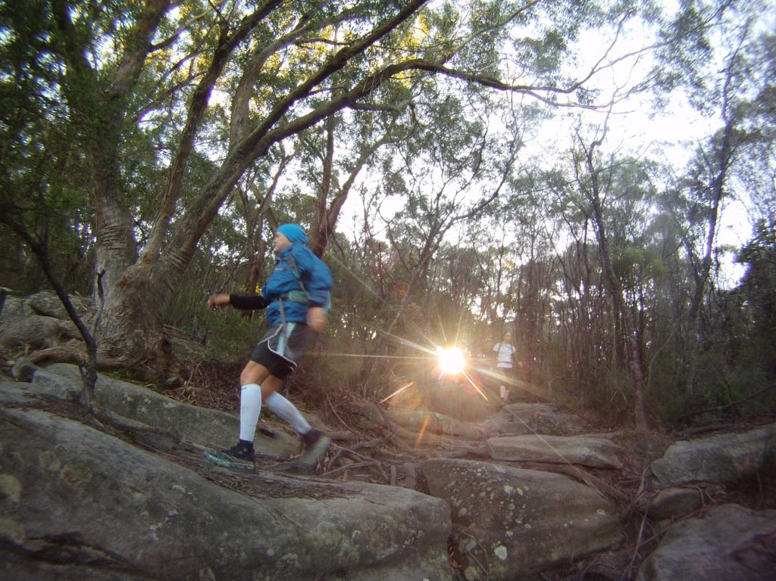
Q. What is ULTRA?

Slide 3
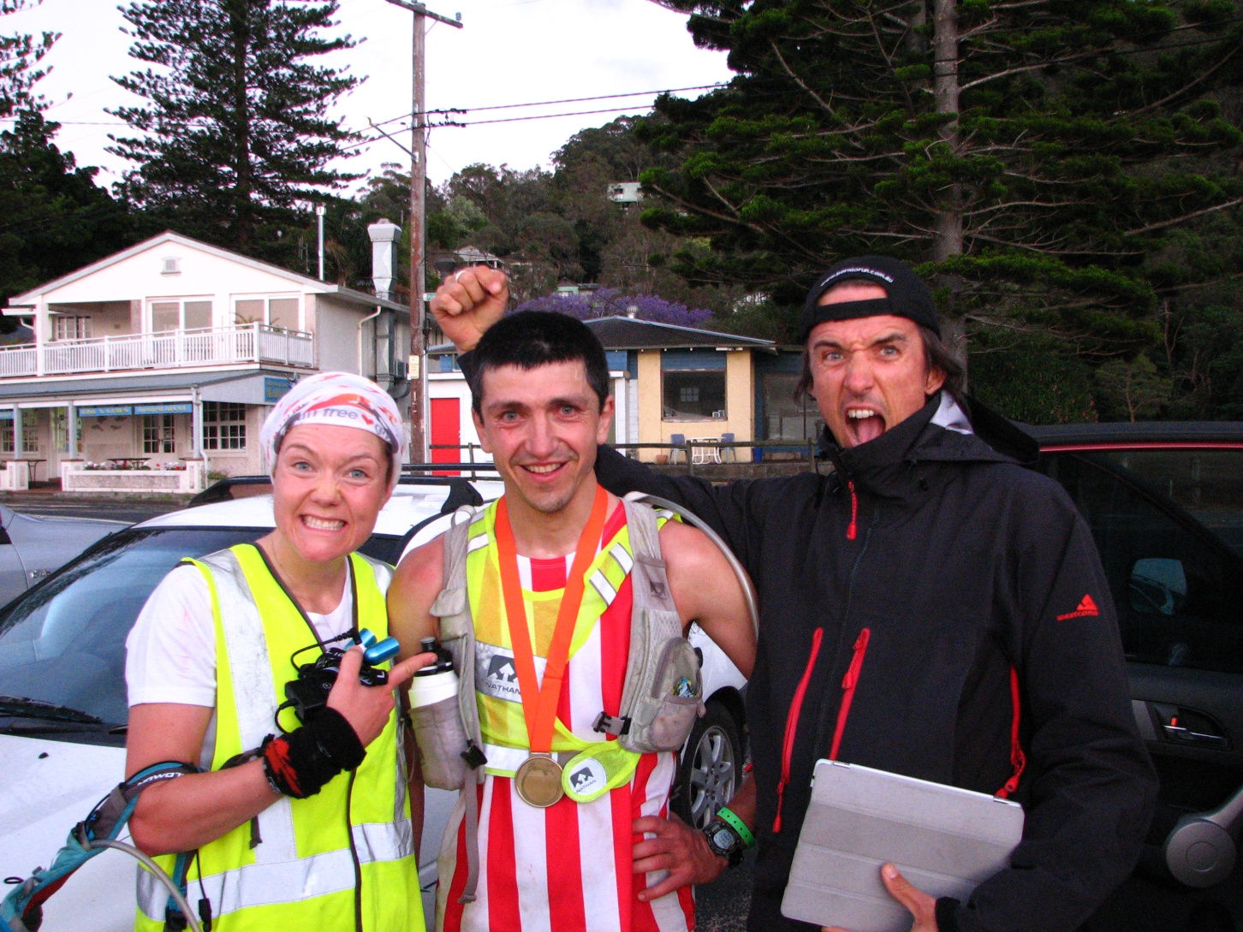
A. Not just >42.2
Our friend Nikolay.
starting to tire at 100km
losing ground and sick at 120km
chasing people down at 150km
2nd place, 5-hour PB at 174km

Slide 4
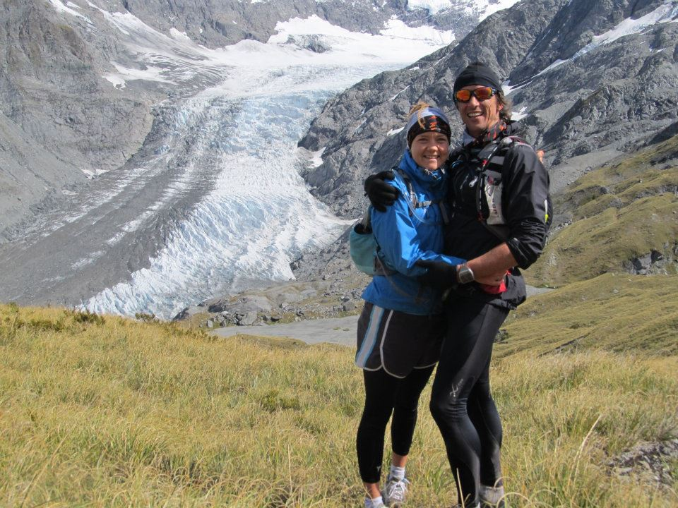
What inspires you to run that long?
Sharing the joy
Of discovery.
Our First Glacier!
Mt. Aspiring
National Park
New Zealand
64km run with a
Kiwi mate,
Malcolm Law

Slide 5
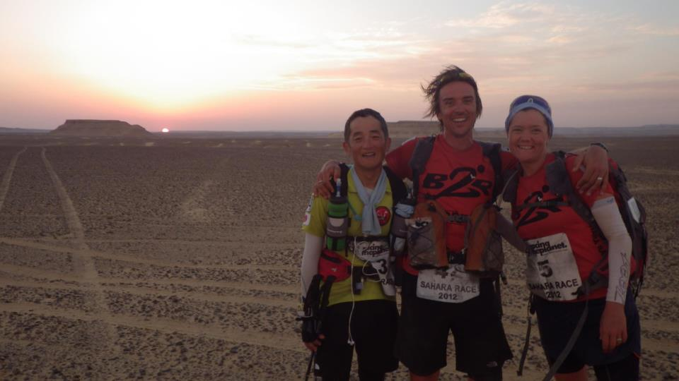
What inspires you to run that long?
Sahara Sunset – 55km done, 30km to go

Slide 6
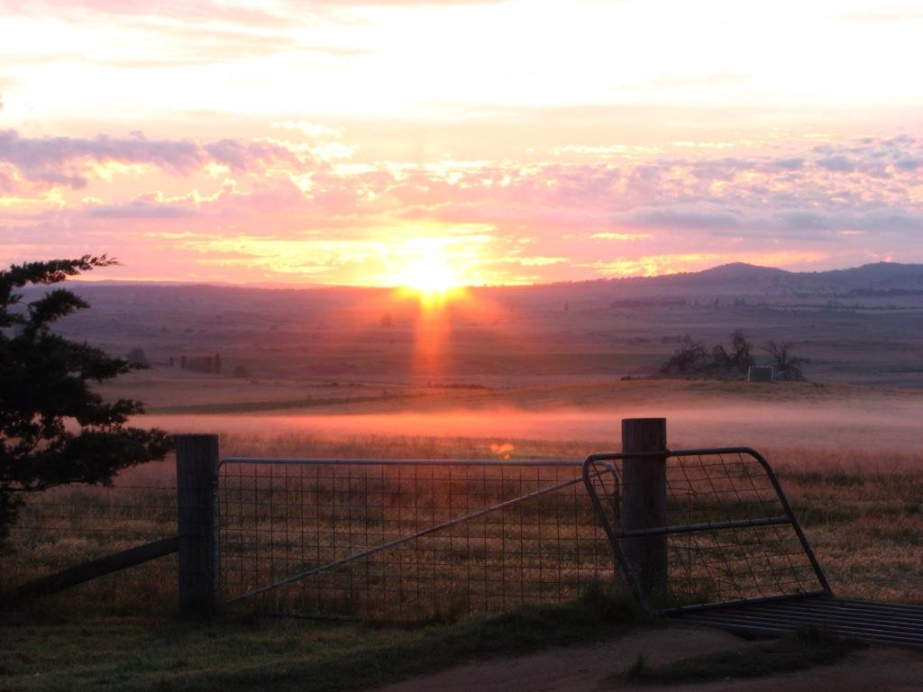
What inspires you to run that long?
Nothing electrifies
like the rising sun
when you’ve
already run through
the night.

Slide 7
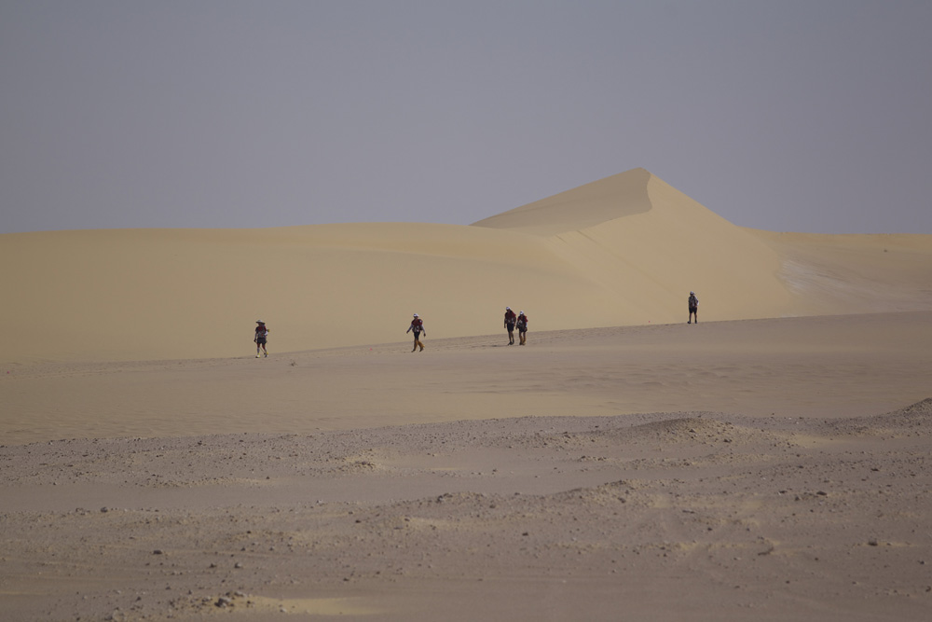
What inspires you to run that long?
All who wander are not lost…

Slide 8
Stupidest thing I have been told about running with Type 1 Diabetes?
“Guess you better do it …
while you still
can”

Slide 9
How do you respond to that kind of ignorance?

Slide 10
Who are these people that think they can tell you what you can’t do?
It’s your responsibility
It’s up to you to find a way forward
You risk everything, by never risking anything

Slide 11
My 2012
February – 212km week in New Zealand
March – 250km week at altitude, Atacama, Chile.
May – The North Face 100km, Sydney
June – 250km week, Gobi Desert, China
October – 250km week, Sahara, Egypt
November/ December – 150km, Antarctica
December – Eden to Kosciuszko, 240km single stage

Slide 12
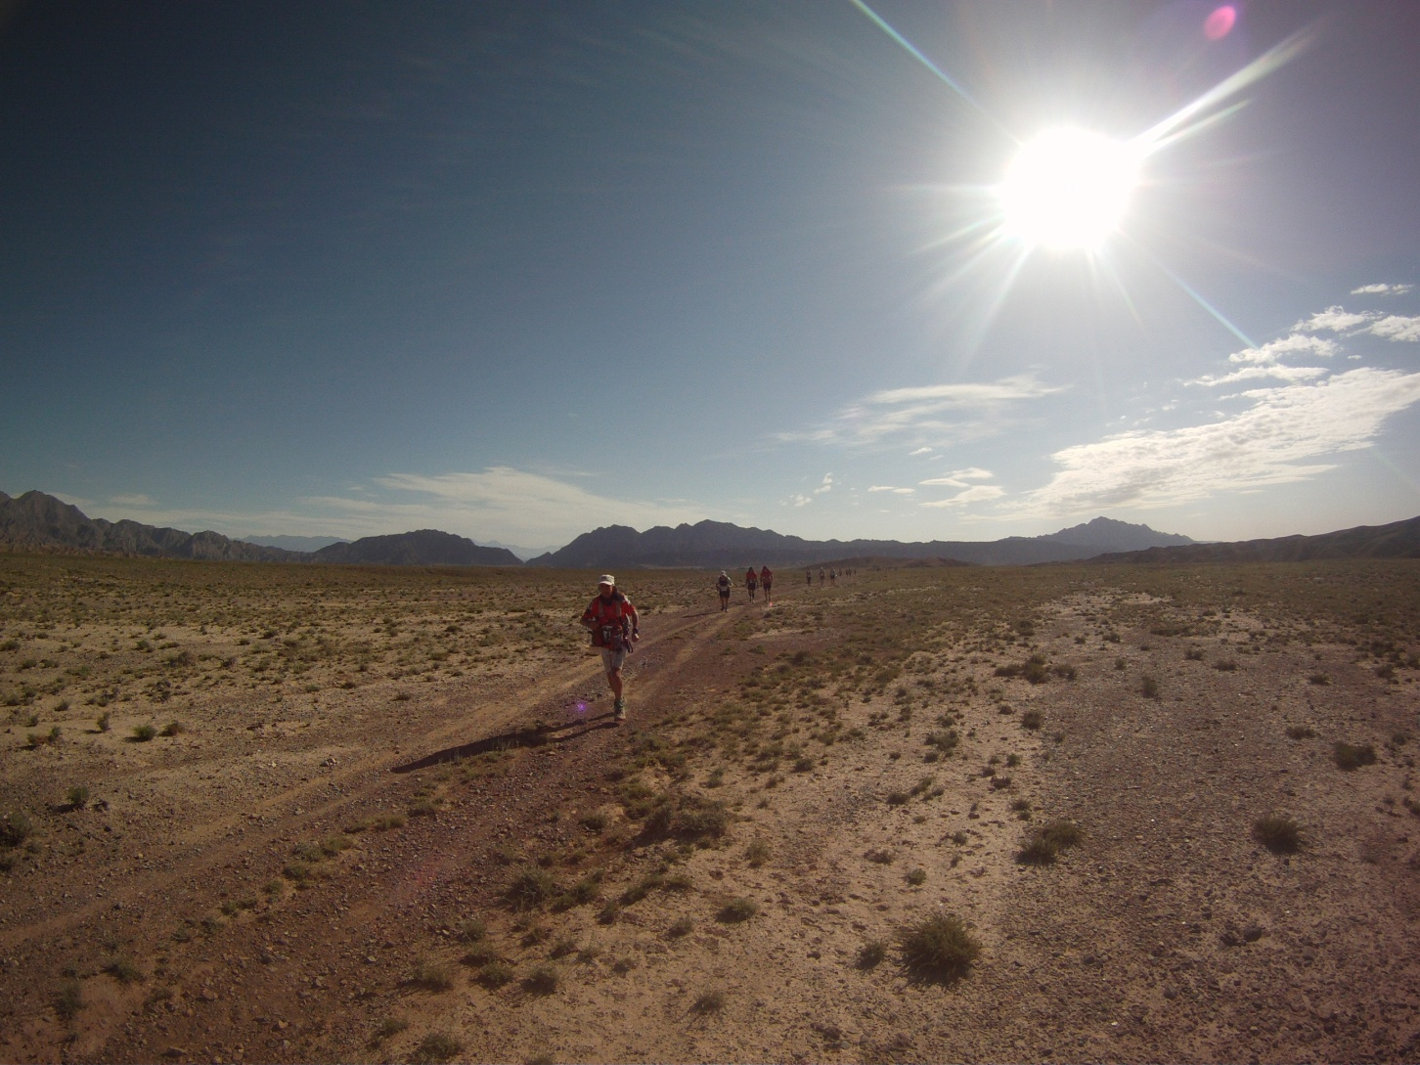
Whose path are you on?

Slide 13
Team Born to Run goes to Gobi
>> insert awesome video<<

Slide 14
The Gobi Realization
The choice between quitting and pushing through is an illusion.
Exclude the option of quitting, then there is no choice.
Get on with deciding HOW to continue,
not WHETHER to continue.

Slide 15
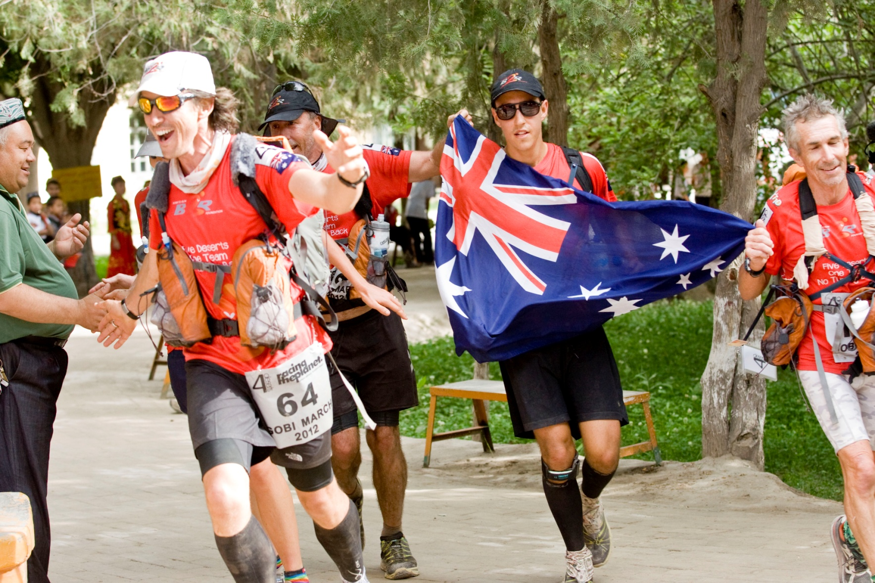
UNSTOPPABLE!!

Slide 17
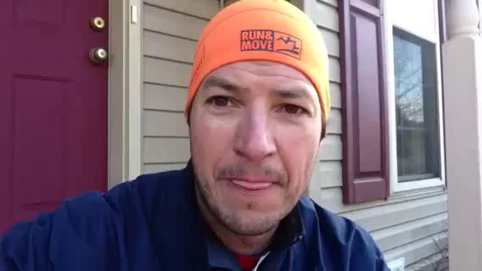
Marcus Grimm - Sweet Victory
certainintelligence.blogspot.com

Slide 18
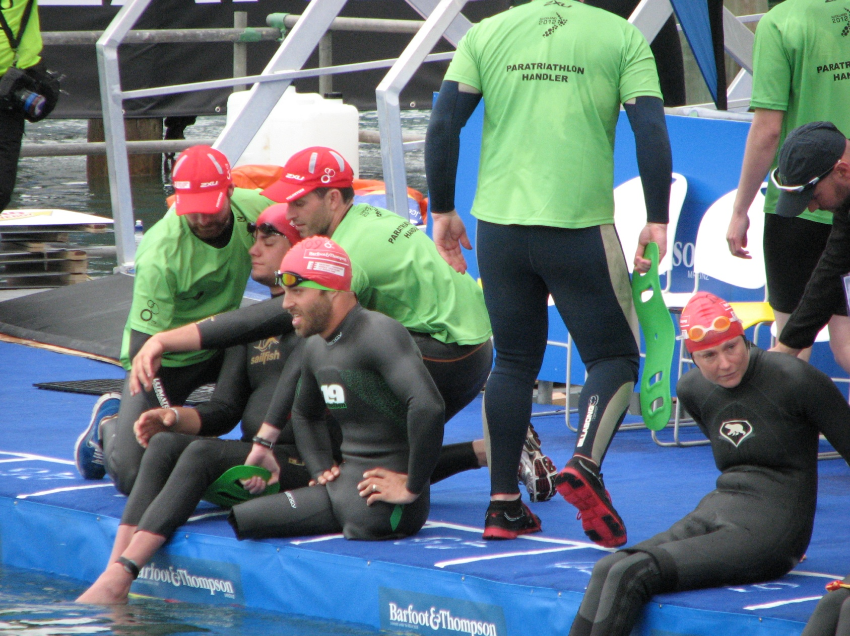
When you think you’ve got it tough

Slide 19
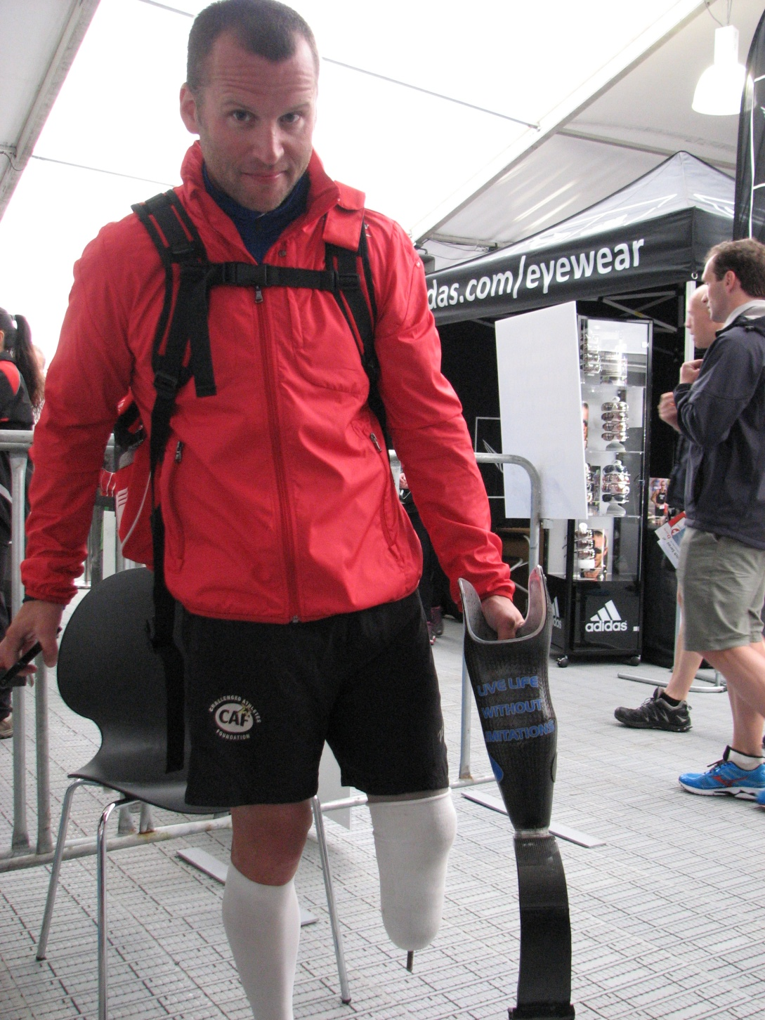
RunNickRun.org
Nick Roumonada
‘Live Life
Without
Limitations’
On the back of his carbon fibre leg.

Slide 20
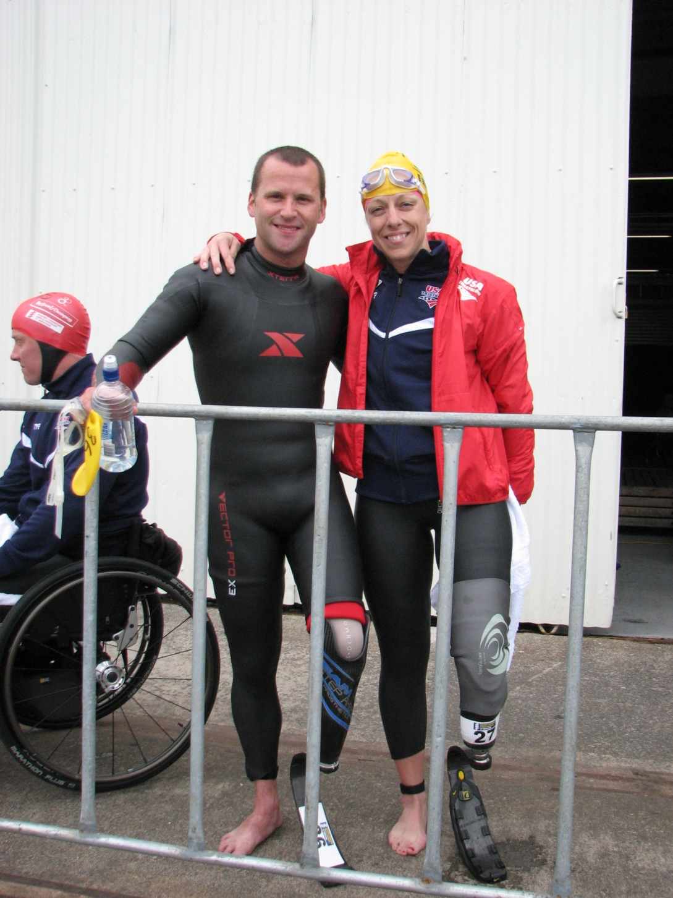
Patti made it back from Iraq in one piece.
Ever heard the expression
“I would give my left leg to be able to…”
?????

Slide 21
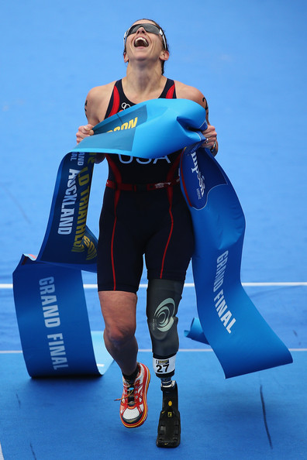
Top of the
World
Patti Collins
Team USA

Slide 22
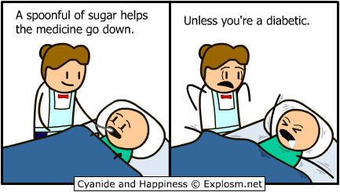
Remember not to take yourself too seriously

Slide 23
Challenges of Ultra Running:
Reaching the START
- illness from fatigue/ impaired immune sytem
- injury from training
- overtraining
- lack of sleep, increasingly emerging as causing/contributing to illness

Slide 24
Ultra Running with Diabetes
- The Delicate Balance -
Level of Exertion
Insulin on Board
Fuelling
Nausea
AND REMEMBER
There’s no prize for having a bad day because of diabetes, although there should probably be a prize for not blaming a bad day on your diabetes.

Slide 25
Other lessons from Desert Ultras
Edge is wider than you think – don’t panic – fear?
Glucose monitor doesn’t work if too cold, or too bright.
Doing the things that scare you will give you more confidence.
- You can run the edge. The edge is wider than you think – don’t panic – fear?
- Glucose monitor doesn’t work if too cold, or too bright.
- Doing the things that scare you will give you more confidence.

Slide 26
Challenges of Ultra Running:
Reaching the FINISH
Before too long, maybe even by the 60km mark you may experience
dizziness
weak legs
cold sweats
fuzzy thinking
SOUND FAMILIAR?
The only way to really fail is to quit

Slide 27
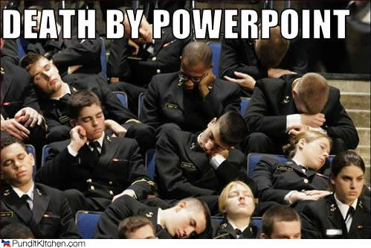
Hang on – we’re nearly there!

Slide 28
Missy Foy
(MissyFoy.com)
Only Type 1 Diabetic yet to qualify for US Olympic marathon trials
Ranked Top 10 in the world for 50 miles (80km) in 2005
2nd US National Championships 50 miles 2007
Pursuing PhD in Medical History

Slide 29
Missy Foy ultra tips for T1Ds
1. always carry carbs with you when training,
2. to add mileage to your long runs, pick a short loop or out-and-back so you can put all your stuff like meter in one place and monitor how you're doing
3. realize that cardio-vascular fitness occurs faster than building muscle strength and if you don't let the muscles catch up you'll get injured, just because the distance "feels" easier doesn't mean you're ready for it yet
4. don't always assume that every problem is because of diabetes, all distance runners get injuries and have problems with their training.

Slide 30
And now…

Slide 31
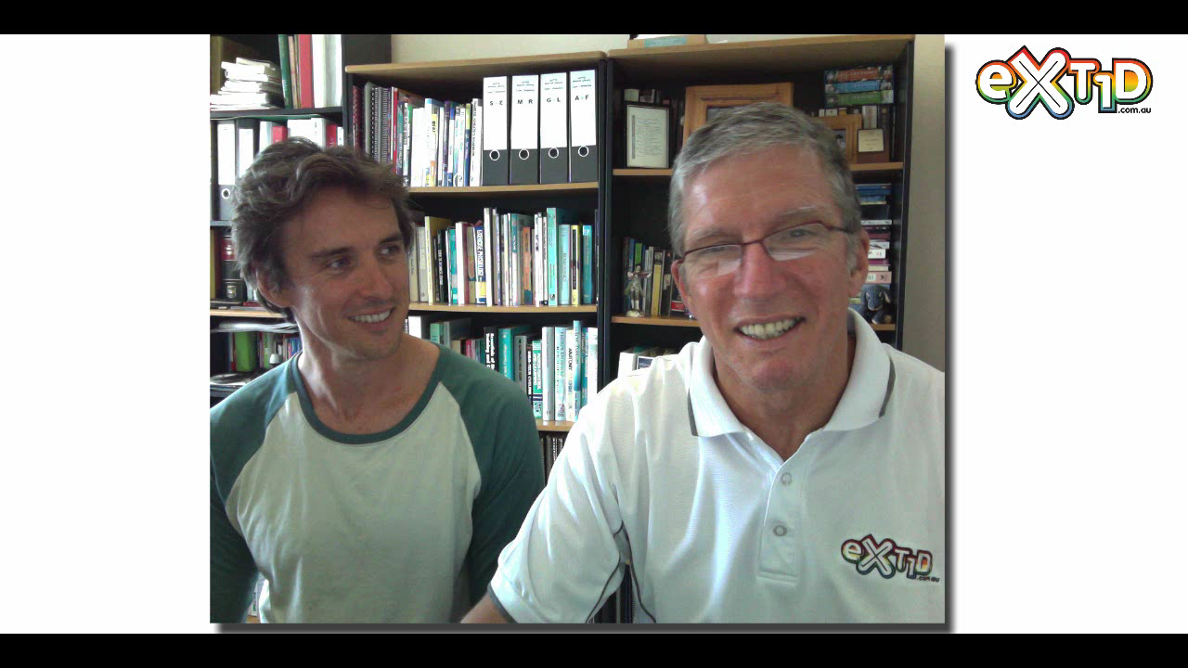

Slide 32
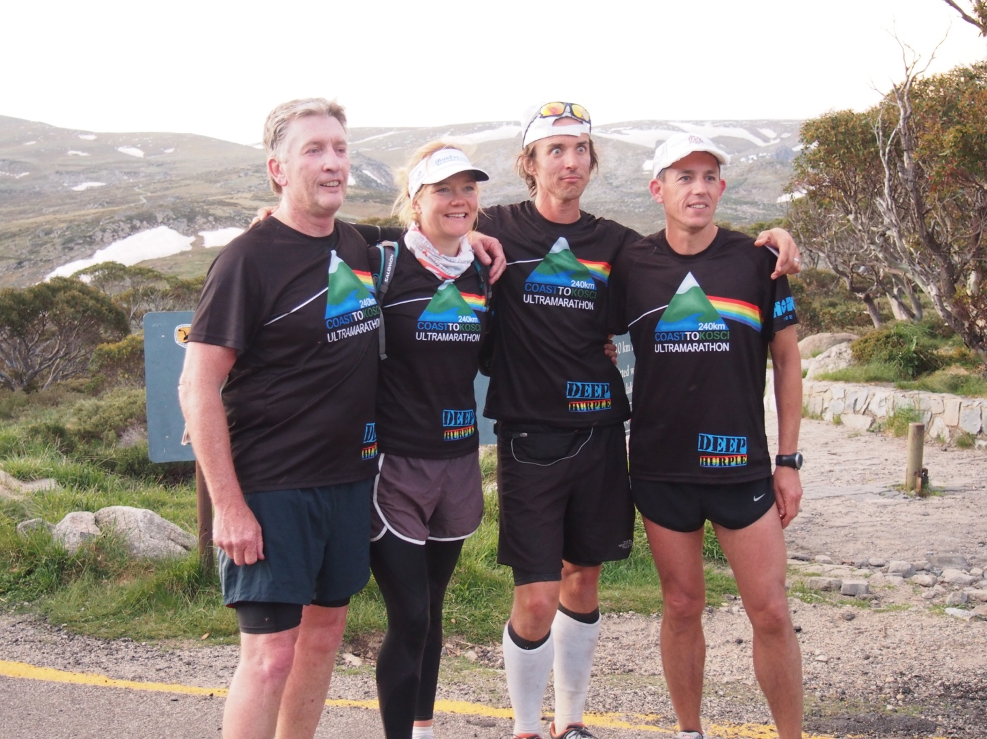

Slide 33
Contact or get involved
My contact details - rogerruns@gmail.com
www.facebook.com/roger.hanney
www.runeatsleeprun.com
Twitter @DirtyTrailFiend
Allan Bolton – www.exT1D.com.au
Marcus Grimm – www.certainintelligence.blogspot.com
Missy Elvin Foy – www.missyfoy.com
Big Red Run – www.facebook.com/bigredrun www.bigredrun.com.au
Born to Run Foundation – www.borntorun.com.au
Team Born to Run – www.facebook.com/teamborntorun
Awesome miraculous running shoes – www.HokaOneOne.com.au

